Slide 1



Green City Situation Awareness
Proof of Concept Demonstrator for Sustainable Transport

Slide 2
Meet the Client
Client Organisation
City of Gold Coast
Client Name
Phillip Karfs
Designations
A/Coordinator Network Intelligence and Transport Systems

Slide 3





Meet the Team
Omkar Kulkarni
Project Manager
Vishal Kumar
Data Analyst
Prof. Elizabeth Chang
Project Guide
PhD – Software Engineering and IT Project Management
Key Achievements:
Led and managed 10+ Multimillion-Dollar Defence contracts
2 patents with the ADF
Viet An Nguyen
Data Analyst
Zhanrui Liao
Data Analyst

Slide 4
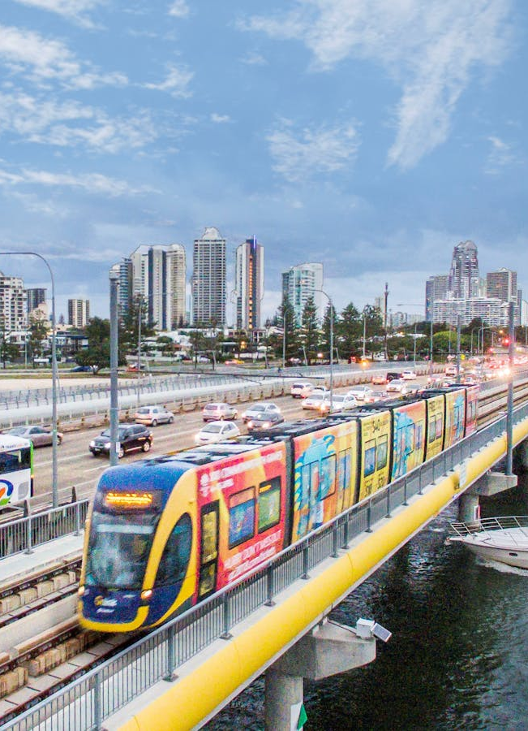
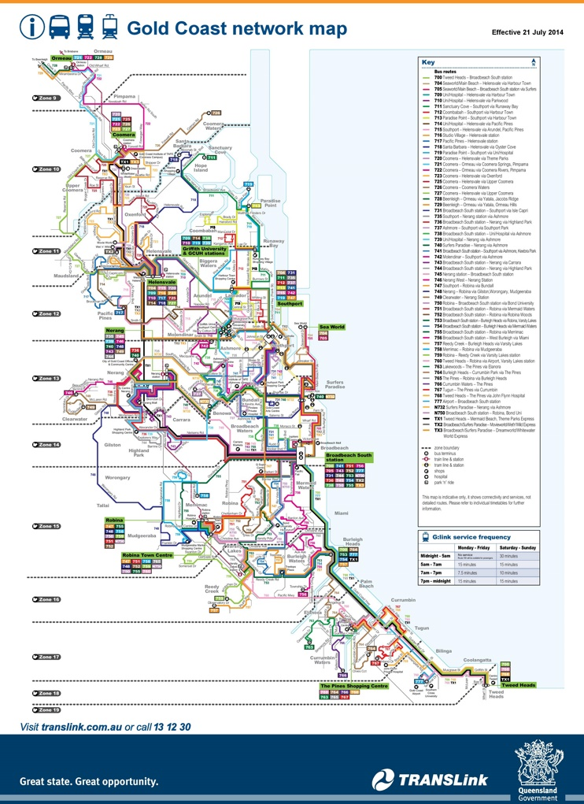
Introduction
The Queensland Government announced a 50c fare initiative from 6th August 2024 as a trial for 6 months.
Under this scheme, passengers can travel on buses, trains, and light rail for just 50c per trip during the trial period.

Slide 5

The Problem
Building a proof of concept to analyse the impact of Queensland’s 50c fare initiative on traffic patterns and CO₂ emissions.

Slide 6

Change in Scope
Geospatial Visualization:
Basic plotting on QGIS was completed, but further analysis was limited due to time constraints.
CO₂ Analysis:
Licensing issue for Sidra.
Prediction Fine-tuning:
Not completed due to time and expertise limitations.

Slide 7
Objectives
Analyse Public Transport Data for Customer Behaviour Changes: Evaluate public transport usage trends by comparing data before and after the 50c fare initiative.
Examine Road Traffic Data: Assess road traffic data, focusing on two key metrics—traffic volume and delay.
Determine Percentage Change in Traffic Volume and Delay Hours: Calculate the % change in traffic volume and the reduction in delay hours to assess the effectiveness of the public transport initiative.

Slide 8
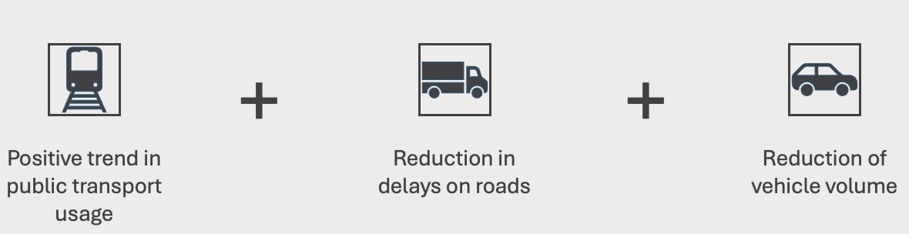
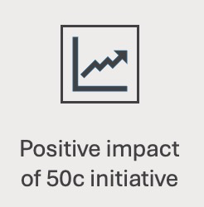
Measuring the Outcome
=

Slide 9

Methodology
Sprint Planning
Weekly Stand-ups
Sprint Review and Retrospective
Product Backlog

Slide 10
Software Requirements
Snowflake
SQL
Power BI
QGIS
Python
Sidra

Slide 11
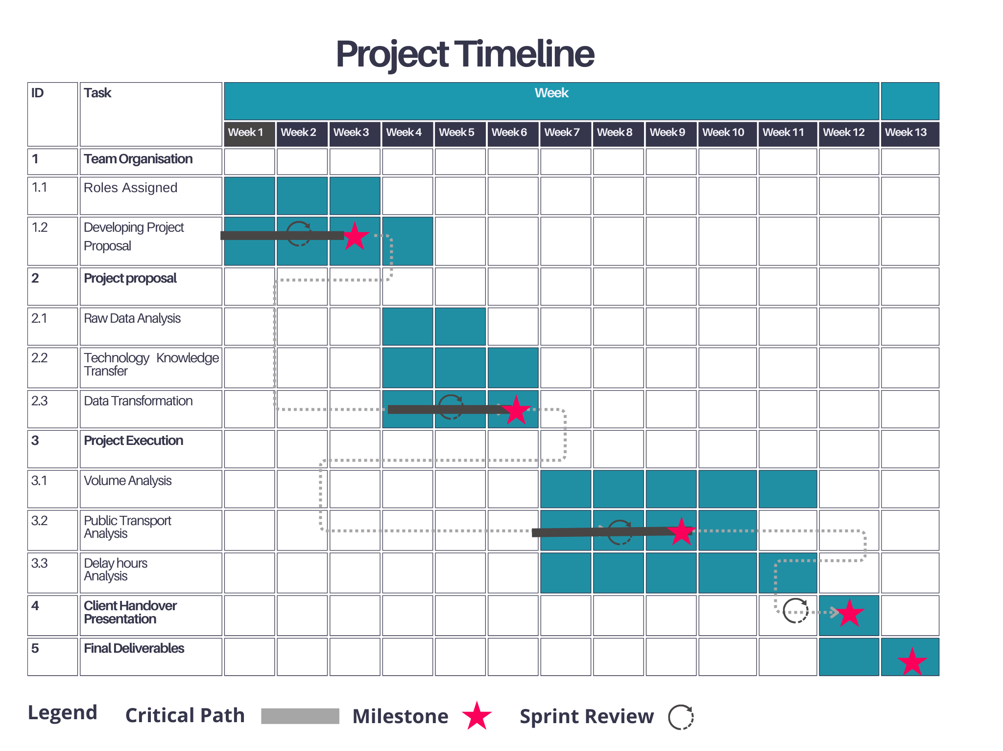
Timeline

Slide 12

Key Insights from Analyses

Slide 13
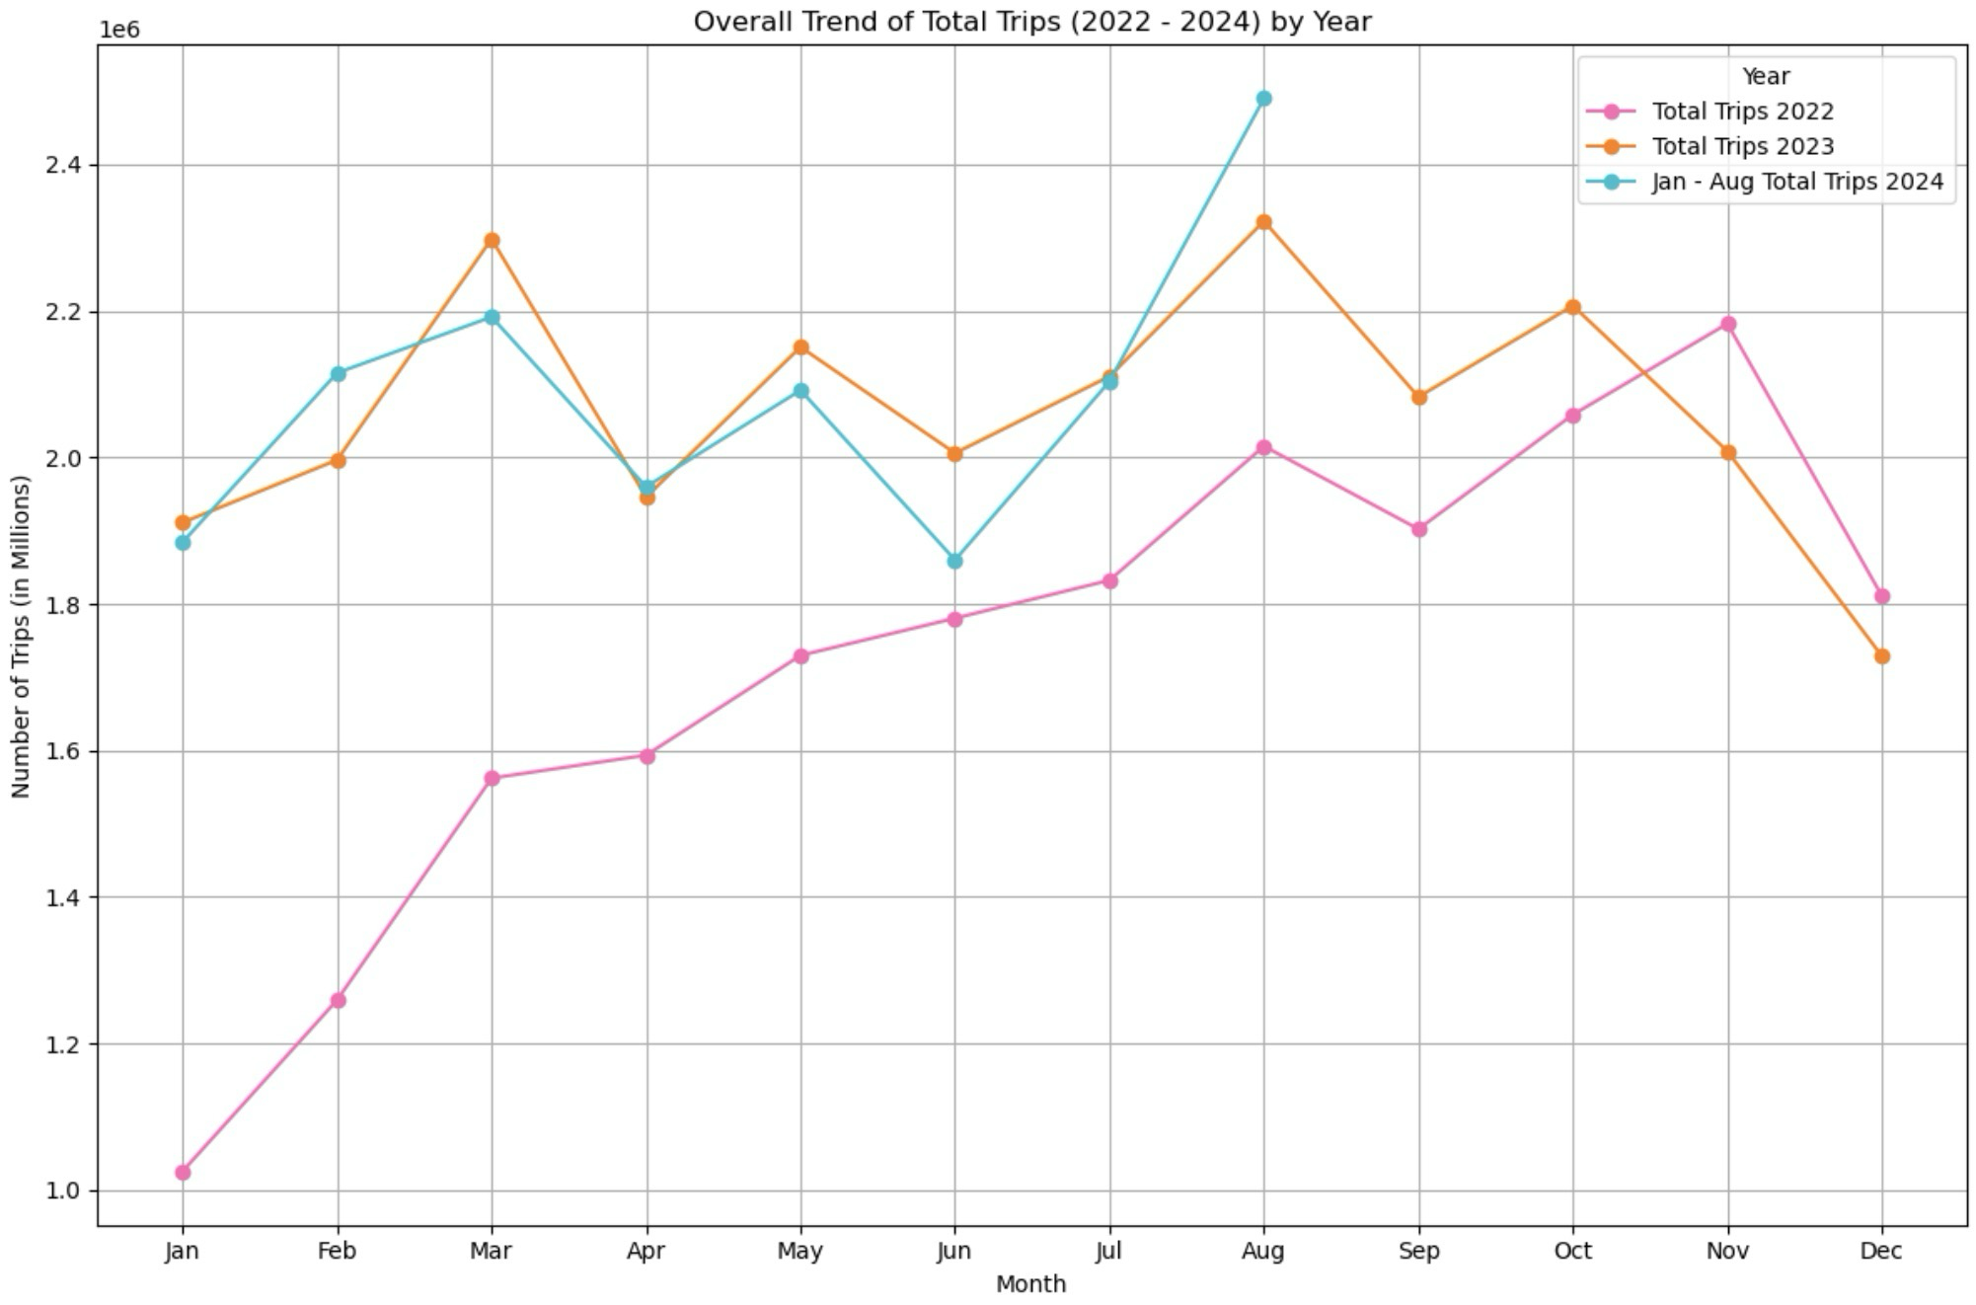
Public Transport Analysis
2024 was following a similar pattern to 2023 but with more variability, especially in the latter part of the year, where August saw noticeable peaks.
There was a 7.22% increase in the total number of trips between August 2023 & 2024.
There was a 15.5% increase in the number of total trips between July and August 2024.

Slide 14
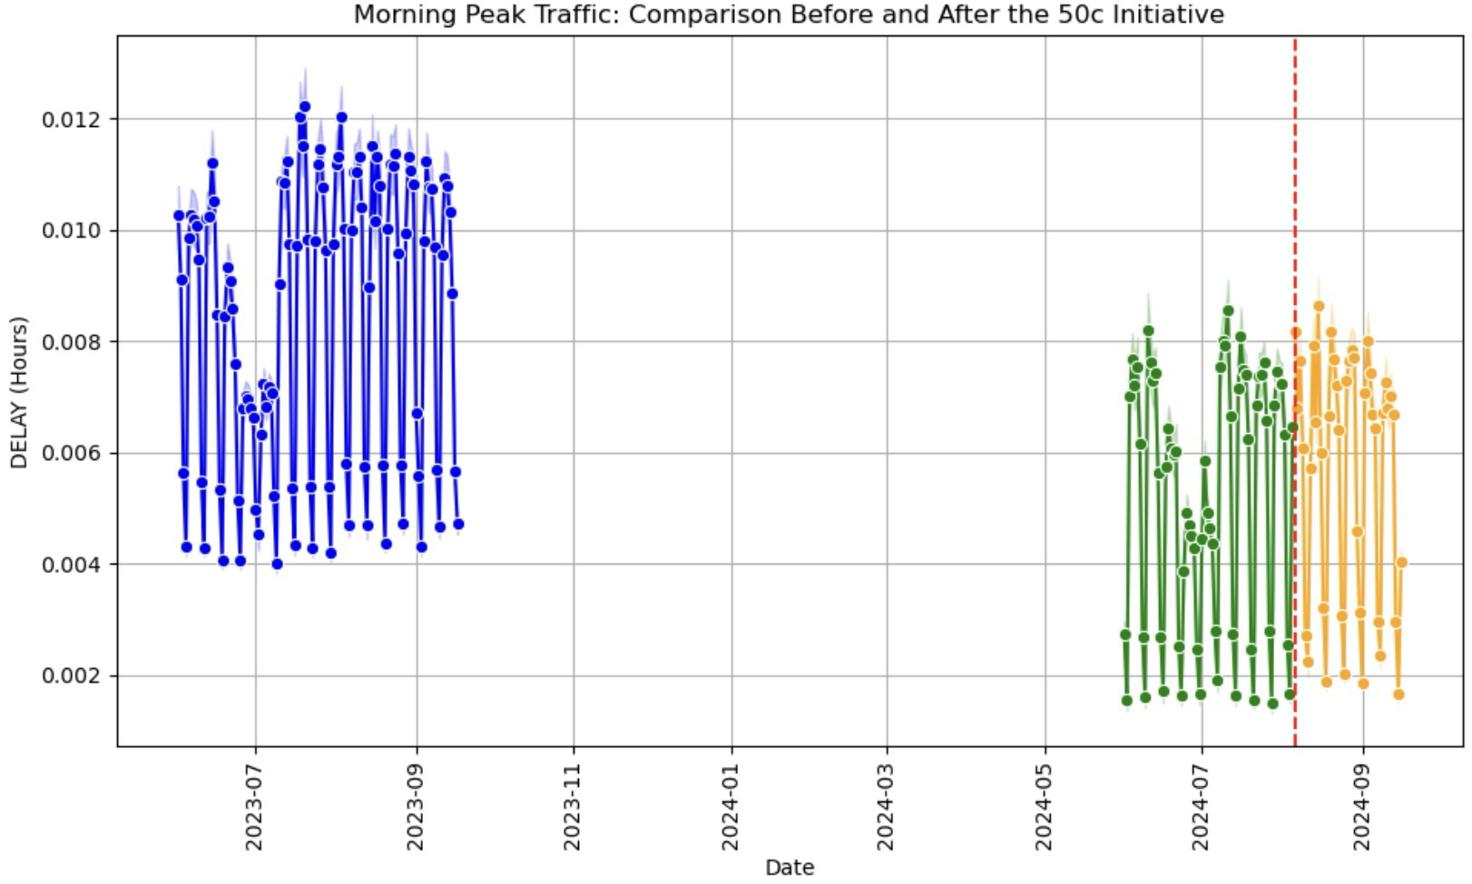
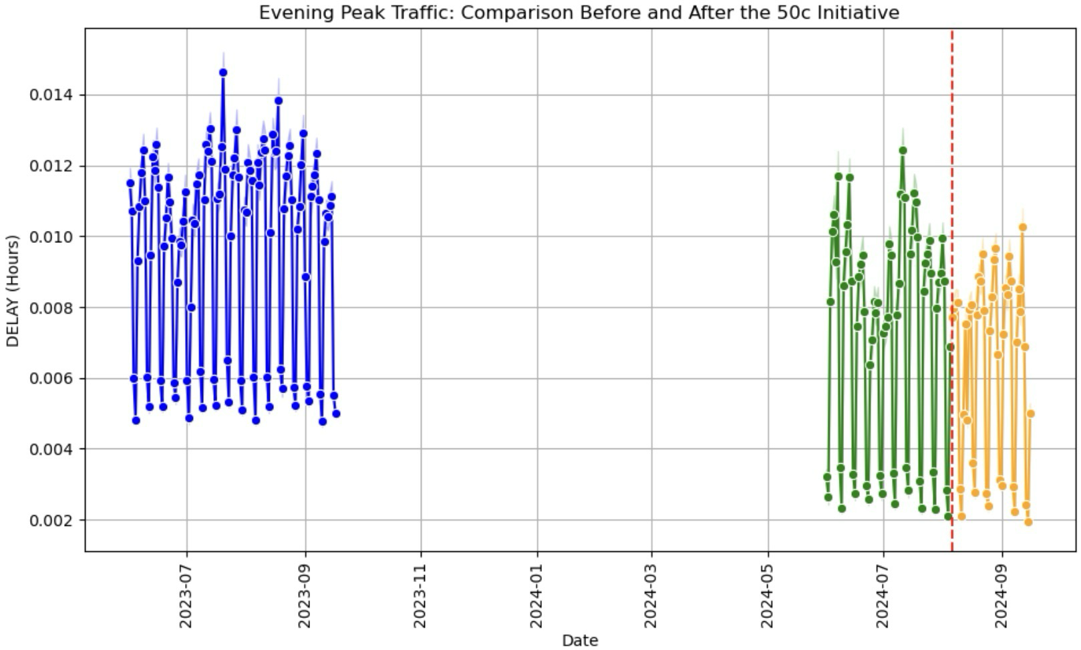
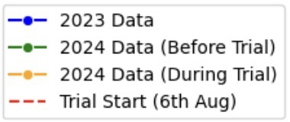
Delay Hours Analysis
Morning Peak Comparison
Evening Peak Comparison

Slide 15
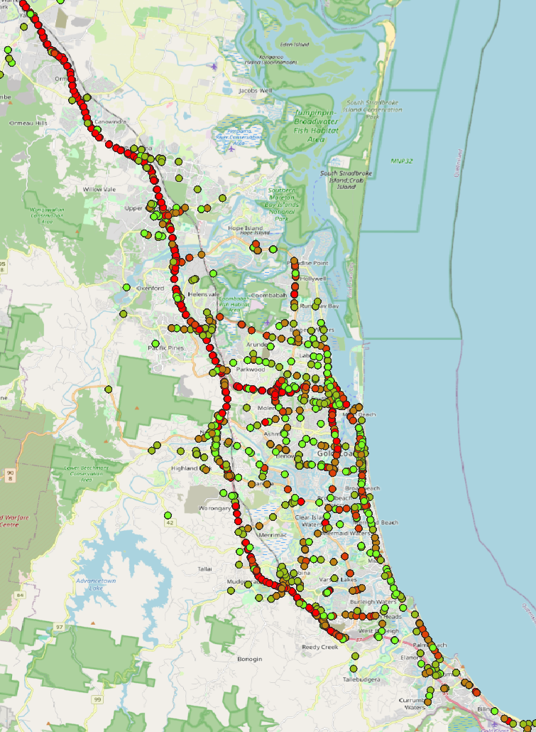
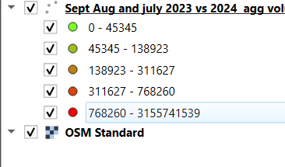
Volume Analysis

Slide 16
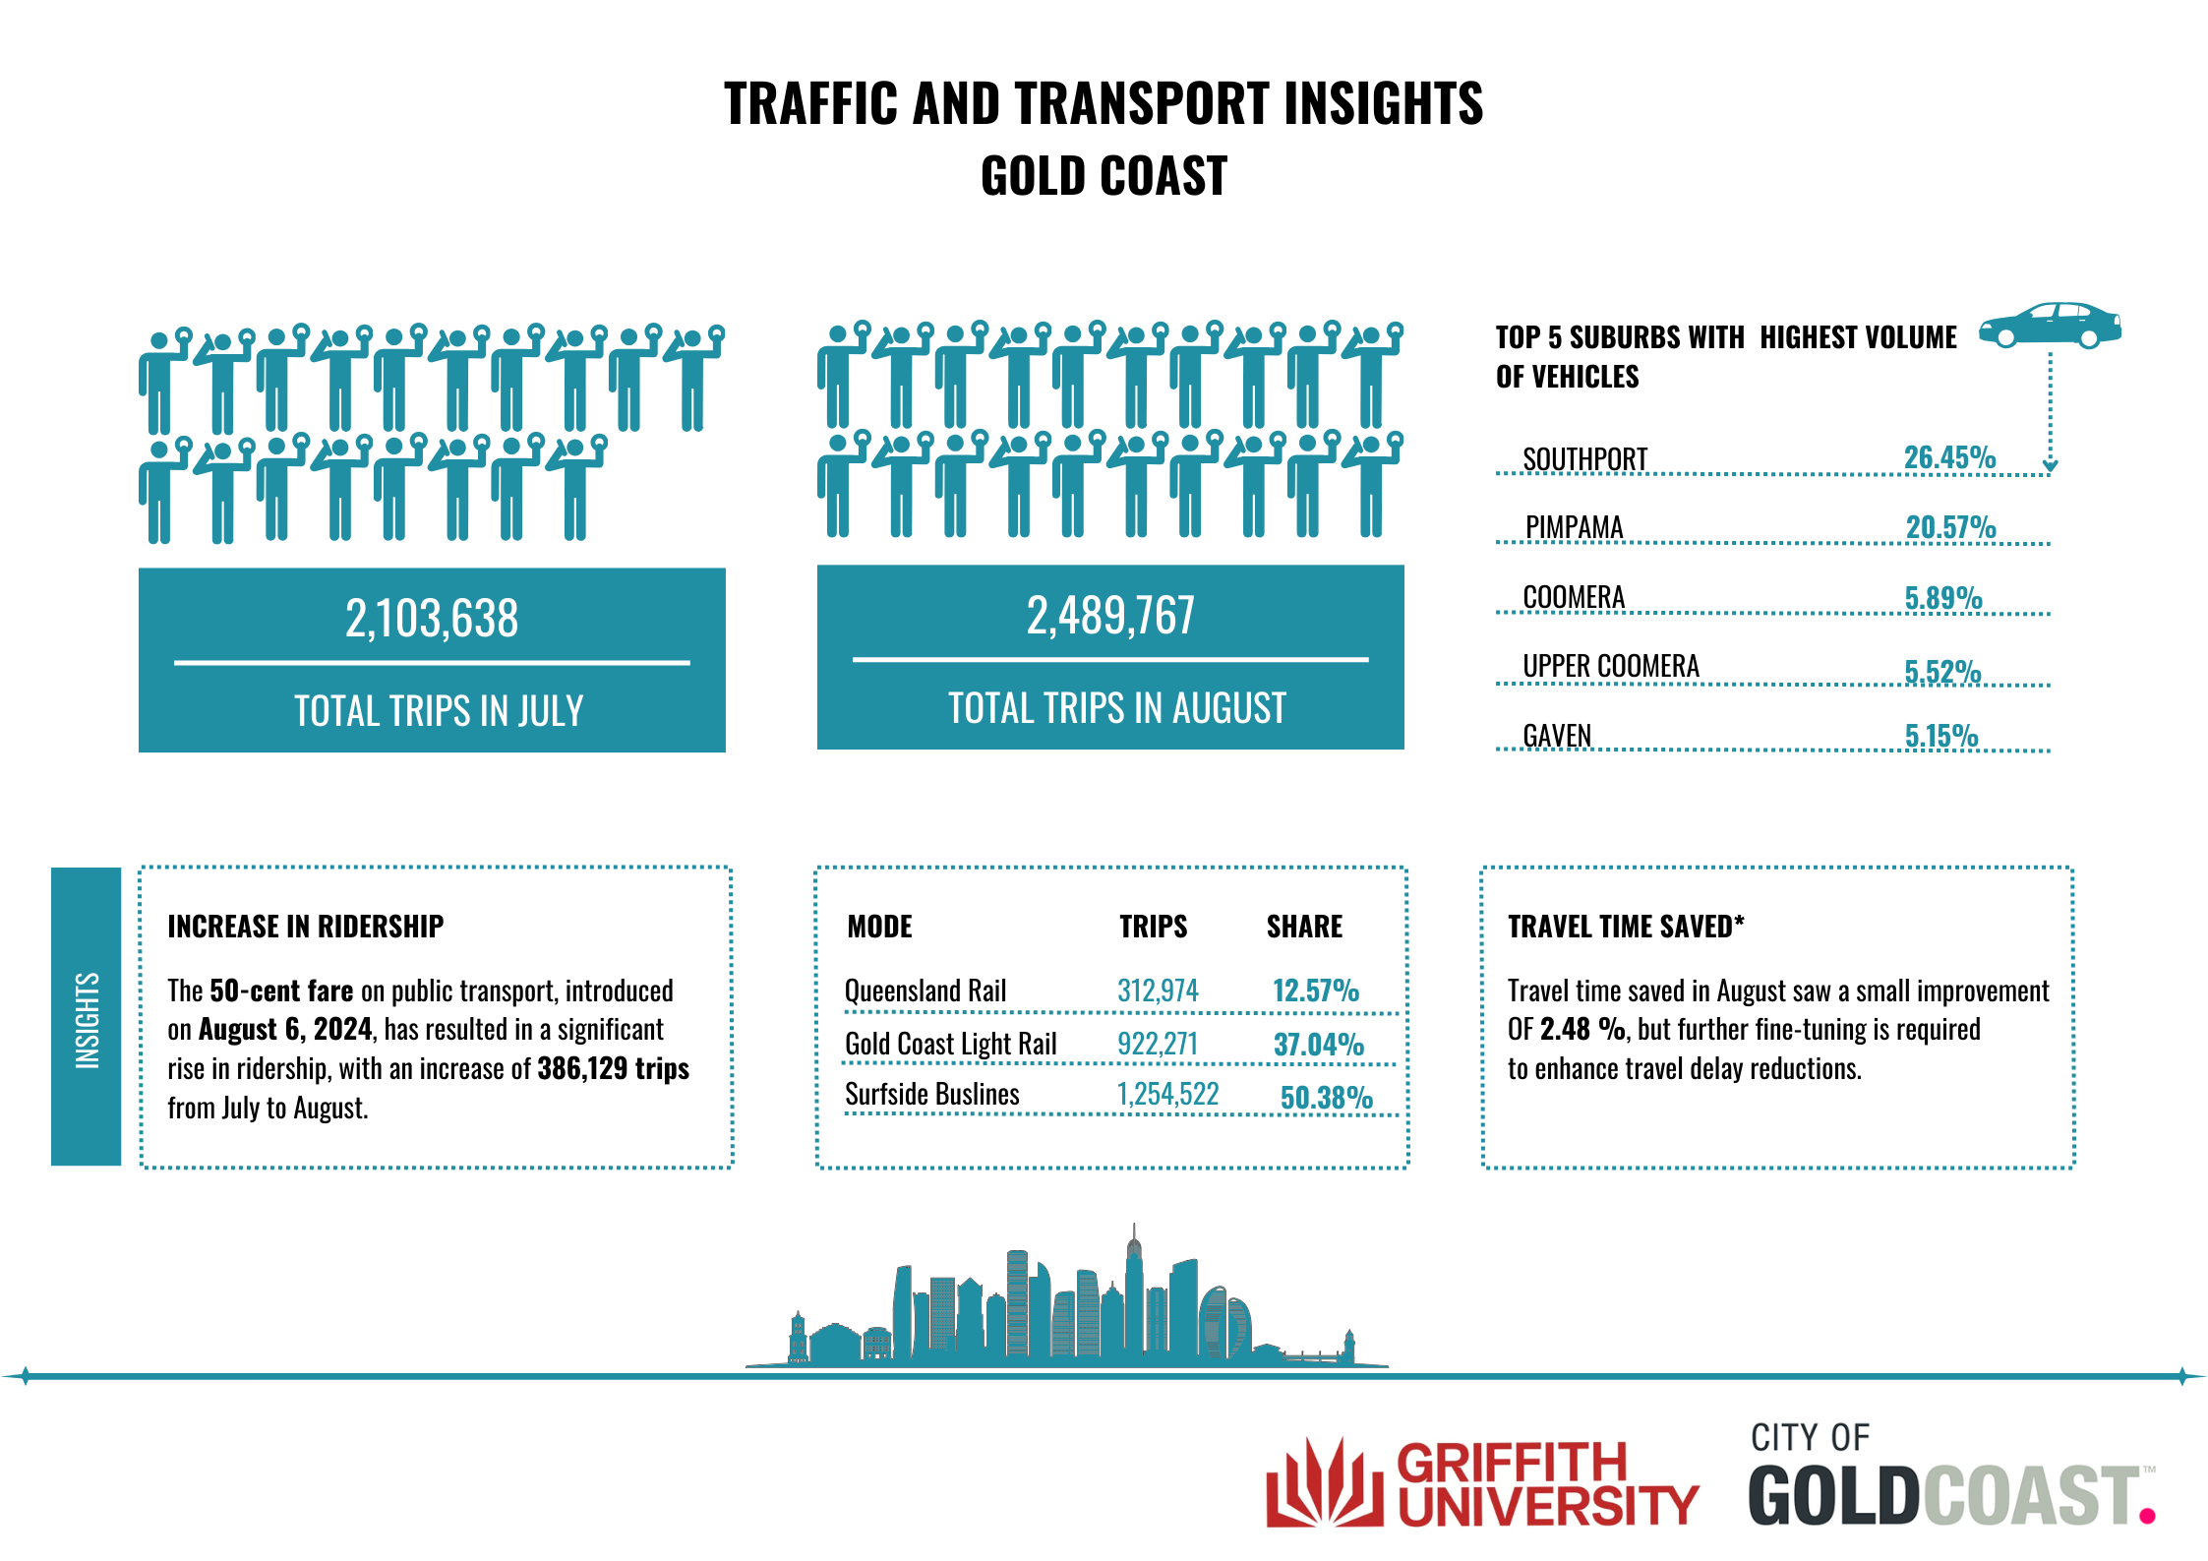
Infographic
Design inspired and referred from: https://www.goldcoast.qld.gov.au/About-our-city/Digital-connectivity/Data-intelligence

Slide 17
Client Feedback Timeline
15/08/2024: Initial Setup and Planning
Overview of Snowflake and assigning user credentials.
23/08/2024: Proposal Submission and Adjustments
Submission of the first proposal.
09/09/2024: Initial Findings and Volume Analysis
Presented initial analysis findings from Snowflake focused on traffic volume.
20/09/2024: Public Transport Data Analysis
Sent the first analysis of public transport data.
23/09/2024: Volume Analysis and Scope Update
Submitted a document comparing two approaches for volume analysis and an update on how we would conclude the project.
01/10/2024: Delay Hours and Public Transport Analysis
Presented the analysis of delay hours and updated public transport analysis.

Slide 18

Reflection on Learnings
Major Learning Outcomes (Team level):
Effective Communication
Collaboration
Adaptability
Time Management

Slide 19
Reflection on Learnings (Personal Level)

Slide 20

Q&A

Slide 21
References
https://translink.widen.net/s/88xvxsxcv7/230619-gold-coast-network-map
https://translink.widen.net/s/pwds2jqbvr/220329-gold-coast-high-frequency
https://translink.widen.net/view/pdf/sf4gubt56n/240805-gold-coast-fare-zones.pdf?u=pgsmuc
https://www.abc.net.au/news/2021-10-17/gold-coast-public-transport/100538104
https://www.goldcoast.qld.gov.au/About-our-city/Digital-connectivity/Data-intelligence

